Slide 1
Welcome to
Standards-Based Assessment
in Mathematics
I am glad you are here today!
While we wait for the session to begin, please:
Make sure you have signed in
Begin to work through the activities “Caterpillars and Leaves” or “Beads under the Cloud”
Feel free to ask ANY questions that you might already have!
Mollie Hall
Math Instructional Lead Teacher
Locust Grove Elementary
Notes:
Before session begins, allow teachers to work on “Caterpillars and Leaves” or “Beads under the Cloud” activity
G0HCH$$3 ( capital "G", numeric zero "0", capital "H", capital "C", capital "H", dollar sign "$", dollar sign "$", numeric three "3" )
If BYOT, no password

Slide 2
Goals for Today
County Formative Assessments
Edited State Math Frameworks
Questions about Performance Based Assessments

Slide 3
How do I know what I know?

Slide 4
What Math Assessments are you giving?

Slide 5
Why are you giving those assessments?
… all those activities undertaken by teachers, and by their students in assessing themselves, which provide information to be used as feedback to modify the teaching and learning activities in which they are engaged. Such assessment becomes “formative assessment” when the evidence is actually used to adapt the teaching work to meet learning needs.
Black and Williams (1998 and summarized in 2001)

Slide 6
Why are you giving those assessments?
The Big Idea of formative assessments:
Students and teachers
Using evidence of learning
To adapt teaching and learning
To meet immediate learning needs
Minute-to-minute and day-to-day.
Marnie Thompson and Dylan Wiliam (2008)
Notes:
Do your students use some type of document to keep up with their own learning on the CFA’s?

Slide 7
What are Common Formative Assessments
or CFAs?
Periodic assessments collaboratively designed by the grade-level
Designed as matching pre- and post-assessments to ensure same-assessment to same-assessment comparison of student growth
Similar in design and format to district and state assessments
Larry Ainsworth; http://www.sde.ct.gov/sde/lib/sde/pdf/curriculum/cali/2fdtcommonformassess.pdf
Notes:
Do your students use some type of document to keep up with their own learning on the CFA’s?

Slide 8
What are Common Formative Assessments
or CFAs?
A blend of items, including selected-response (multiple choice, true/false, matching) and constructed-response (short- or extended)
Administered to all students in grade level several times during the quarter, semester, trimester, or entire school year
Student results analyzed in Data Teams to guide instructional planning and delivery
Larry Ainsworth; http://www.sde.ct.gov/sde/lib/sde/pdf/curriculum/cali/2fdtcommonformassess.pdf
Notes:
Do your students use some type of document to keep up with their own learning on the CFA’s?

Slide 9
What are the benefits of CFAs?
Regular and timely feedback, which allows teachers to modify instruction
Multiple-measure assessments that allow students to demonstrate their understanding of standards in a variety of formats
Ongoing collaboration opportunities for grade-level teachers
Consistent expectations within a grade level regarding standards, instruction, and assessment priorities
Agreed-upon criteria for proficiency to be met within each individual classroom, grade level, school, and district
Deliberate alignment of classroom, school, district, and state assessments to better prepare students for success on state assessments
Results that have predictive value as to how students are likely to do on each succeeding assessment, in time to make instructional modifications

Slide 10
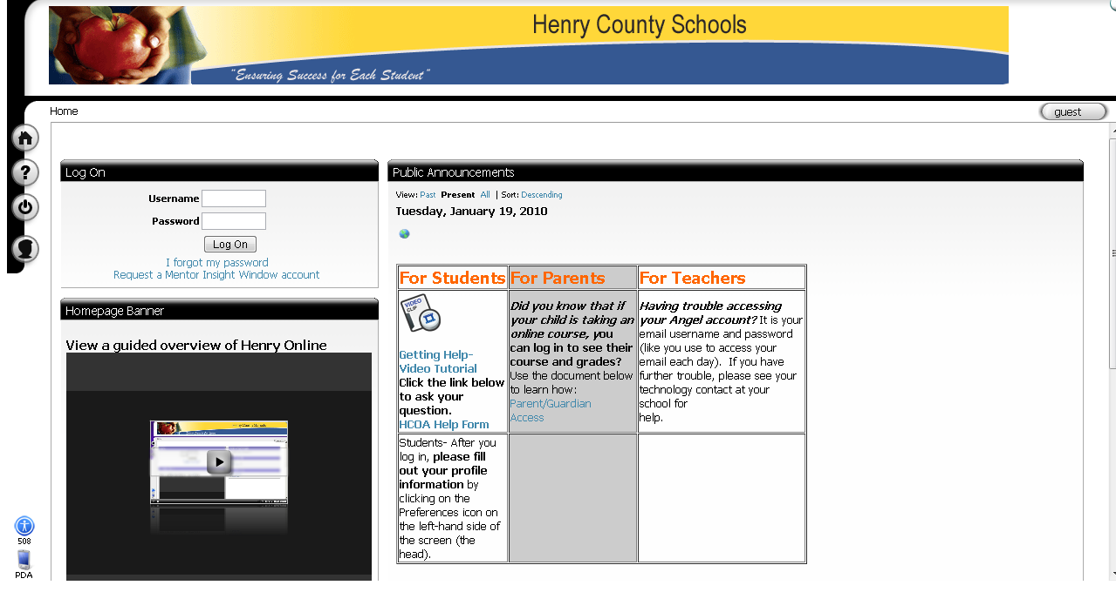
Where can I get CFAs?
From Angel
Should be your email user name (mhall) and current email password

Slide 11
Where can I get CFAs?
From Angel

Slide 12
Where can I get CFAs?
From Angel
Pick YOUR grade level folder

Slide 13
Where can I get CFAs?
From Angel
Pick the math folder

Slide 14
Where can I get CFAs?
From Angel
Notes:
All grade levels EXCEPT 1st grade has common assessments. 1st grade has BOY and EOY assessment. Spend time looking through several of the common formative assessments and asking teachers about purpose. Remind teachers to use the NEW curriculum map to pull CFA’s Kindergarten: units 1 – 5 have changed order; 1st, 2nd and 5th grade has NOT changed order at all; 3rd combined units 3 and 4 so they only have 7 units; 4th grade has units 2 – 4 changed

Slide 15
Let’s try a CFA!
“Welcome Back Party” is page 5 /6 of Grade 3 - Unit 1 Common Assessments. There are 7 total assessments in Unit 1.
Notes:
Have teachers work through task and then use rubric to “grade” each other’s work.

Slide 16
What is a FAL?
Formative
Assessment
Lesson

Slide 17
What is a FAL?
1. The concept-focused FALs have three main components:
Pre-Lesson Assessment
The Lesson
Post-Lesson assessment
2. The problem-focused FALs have this structure:
Students make an initial attempt at the problem (Pre-Assessment)
Feedback on the initial attempt and reengagement
Collaborative attempt at the problem, analysis of sample student responses
Reflection on the problem-solving process

Slide 18
Where can I get FALs?
From Learning Village
Notes:
Show the log-in button and the Chrome Browser – embedded into each framework or go to wikispaces
mhall@henry.k12.ga.us
Simon544!
Remind them the frameworks should say “July 2013” on the bottom

Slide 19
Where can I get FALs?
From Learning Village

Slide 20
Where can I get FALs?
From Learning Village

Slide 21
Where can I get FALs?
From Learning Village
Notes:
And of course, I will be happy to email you all of the new units and resources too!

Slide 22
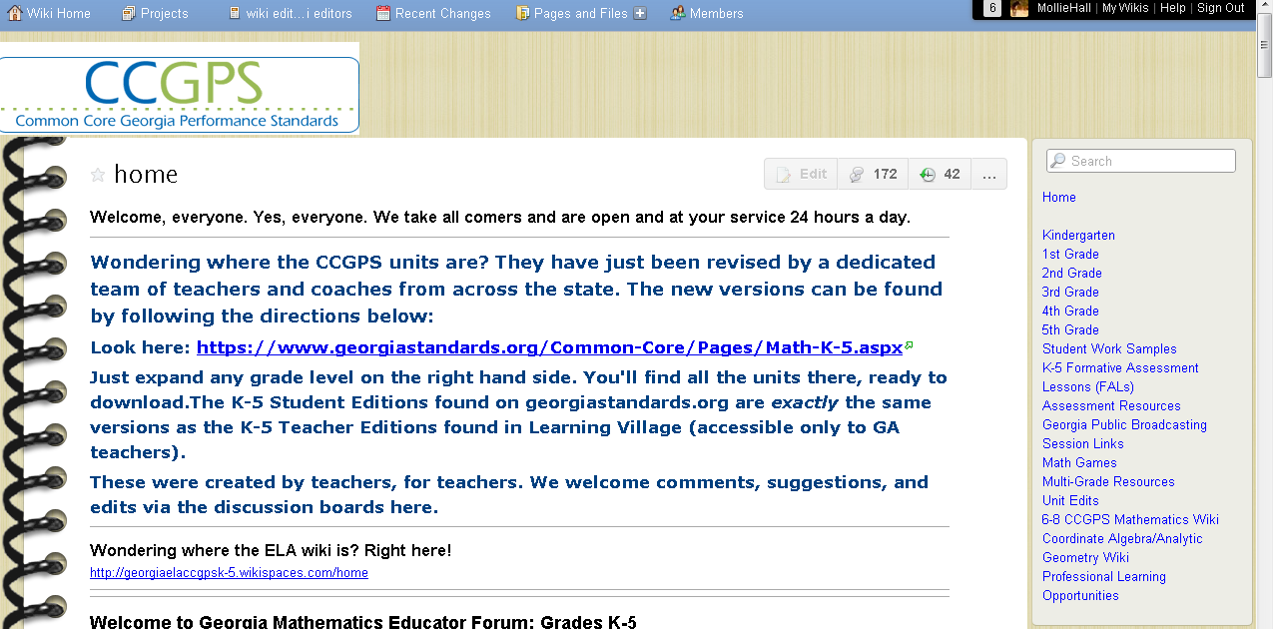
Where can I get FALs? http://ccgpsmathematicsk-5.wikispaces.com/

Slide 23
Quote from State Frameworks
“The linked Formative Assessment lesson is designed to be part of an instructional unit. This assessment should be implemented approximately two-thirds of the way through this instructional unit and is noted in the unit task table. This assessment can be used at the beginning of the unit to ascertain student needs. The results of this task should give you pertinent information regarding your students learning and help to drive your instruction for the remainder of the unit.”

Slide 24
State Frameworks

Slide 25
What FALs are available for my grade level?
Kindergarten 3rd Grade
Counting Dots Attributes of a Shape
Decomposing Dots Fractions on a Number Line
Snail in the Well Multiplication
Measurement Strategies for Subtraction
1st Grade 4th Grade
Caterpillars and Leaves Arrays, Number Puzzles and Pieces of a Hundreds Chart Factors
Measurement Multi-digit Multiplication
2nd Grade 4th and 5th Grade
Place Value Where are the Cookies?
Caterpillars and Leaves Beads Under the Cloud
Measurement
2 digit computation mental math 5th Grade
Division and Interpreting Remainders
Decimals
Notes:
Mention 1st grade has summative assessments also available

Slide 26
Let’s try a Fal!
Arrays, Number Puzzles and Factors is from Fourth Grade Unit 2 and Fifth Grade Unit 4

Slide 27
Standards-Based Assessments in Mathematics?
What have you learned about
Thank you for coming today!!
Assessments

